Slide 1
Agenda for today
Today we will do another tutorial example together to continue introduction to Lumerical FDTD software.
Task #1: Tune the resonance frequency of a gold nanobar using the parametric sweep feature of Lumerical FDTD.
Task #2: Calculate the Q-factor of the resonant mode
Next week: Begin discussing waveguide simulations

Slide 2
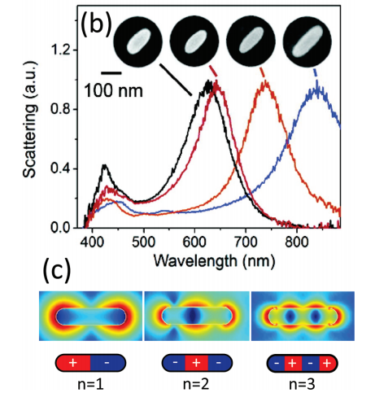
Optimizing gold nanobar resonance
Gold nanobars behave like dipole antennas and resonantly scatter light.
Resonance length is roughly $λ/2$ (same as dipole antenna) but typically smaller than this because of kinetic inductance (i.e. electron lags behind field causing the “plasmonic” effect).

Slide 3
Optimizing gold nanobar resonance
PML
Plane wave
Using Lumerical FDTD, we would like to optimize the length of a gold nanobar such that the resonance wavelength of the nanobar is roughly 800nm
We will use broadband plane wave source to excite the gold nanobar embedded in air medium.
Computational domain will be terminated by PML on all sides
PML
PML
nanobar
length
PML

Slide 4
Create ‘nanobar’ geometry
We will create a rectangle consisting of gold.
To create a rectangle and edit the properties:
Structures → Rectangle
Right click on rectangle in Objects Tree; select Edit object

Slide 5
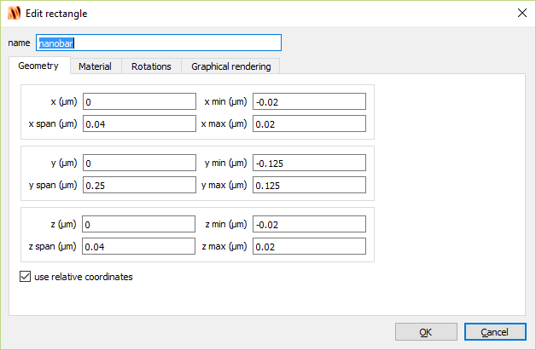
Create ‘nanobar’ geometry

Slide 6
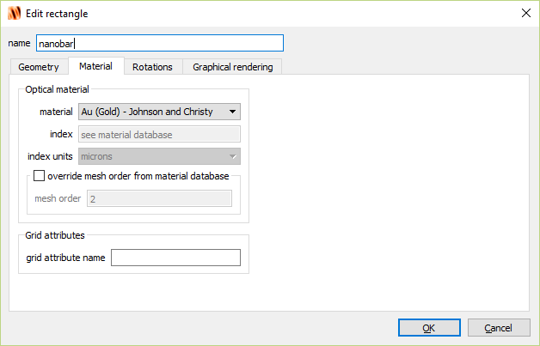
Create ‘nanobar’ geometry

Slide 7
Create simulation window
To create a simulation window and edit the properties:
Simulation → Region
Right click on FDTD in Objects Tree; select Edit object

Slide 8
Create simulation window

Slide 9
Create simulation window

Slide 10
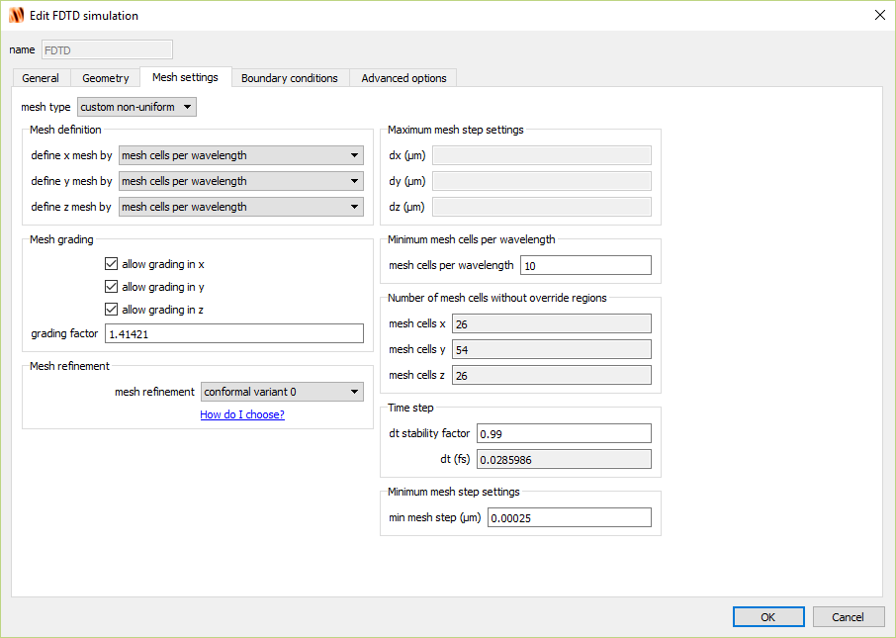
Create simulation window

Slide 11
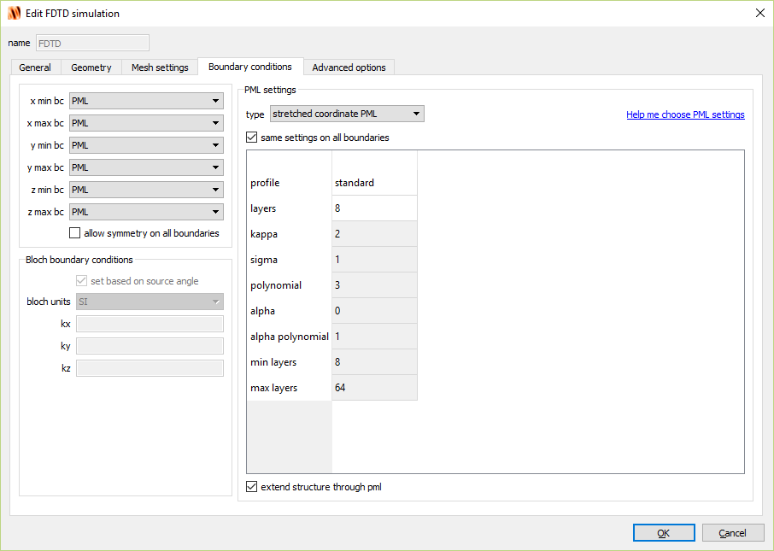
Create simulation window

Slide 12
Create mesh refinement
To create a simulation window and edit the properties:
Simulation → Mesh
Right click on mesh in Objects Tree; select Edit object

Slide 13
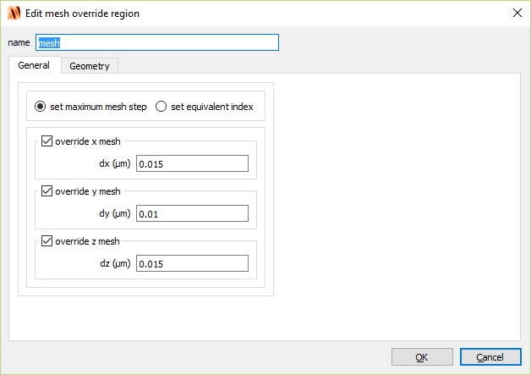
Create mesh refinement

Slide 14
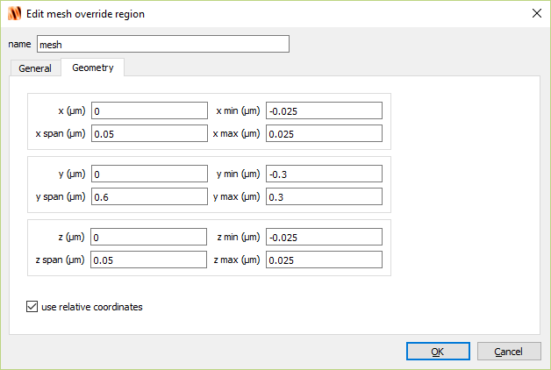
Create mesh refinement

Slide 15
Create source
To create a simulation window and edit the properties:
Sources → Plane wave
Right click on source in Objects Tree; select Edit object

Slide 16
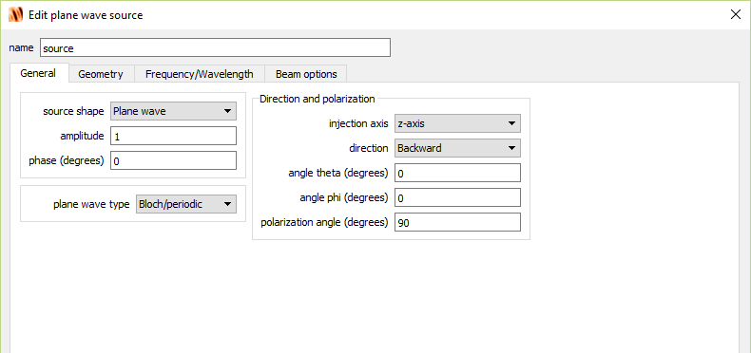
Create source

Slide 17
Create source

Slide 18
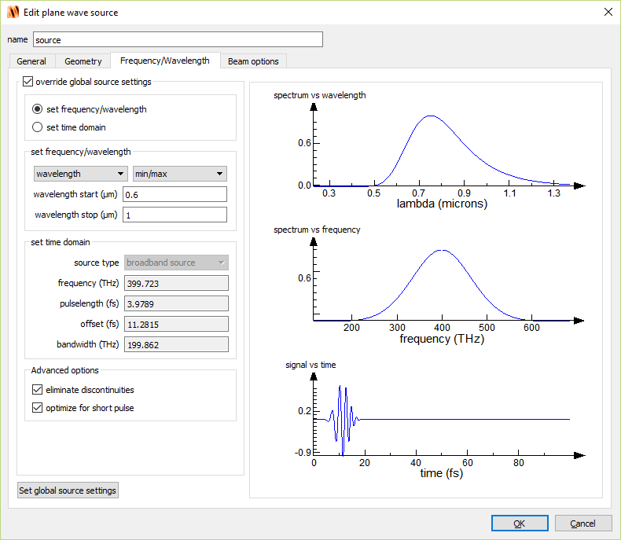
Create source

Slide 19
Create field monitor
To create a simulation window and edit the properties:
Monitors → Frequency-domain field and power
Right click on DFTMonitor in Objects Tree; select Edit object

Slide 20
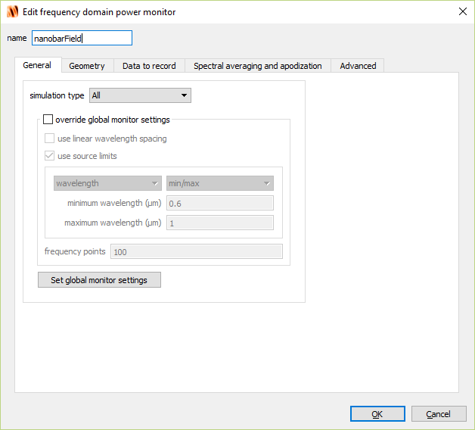
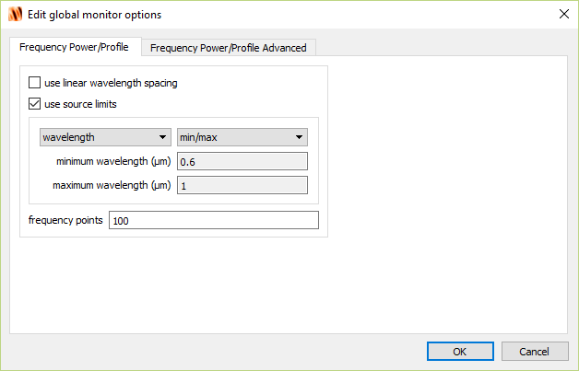
Create field monitor

Slide 21
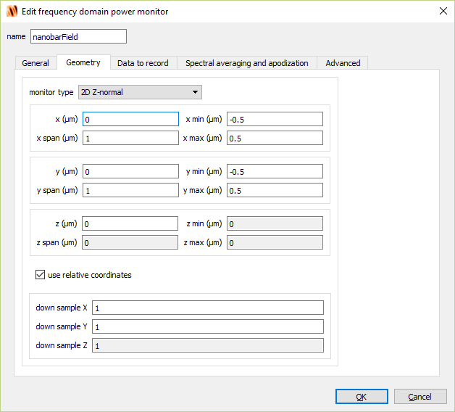
Create field monitor

Slide 22
Create movie monitor
To create a simulation window and edit the properties:
Monitors → Movie
Right click on MovieMonitor in Objects Tree; select Edit object

Slide 23
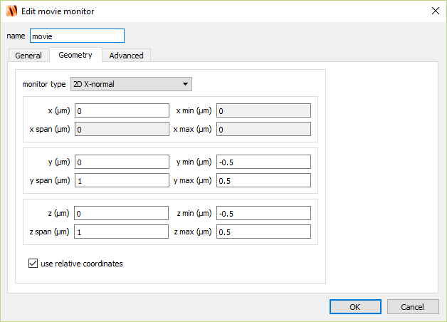
Create movie monitor

Slide 24
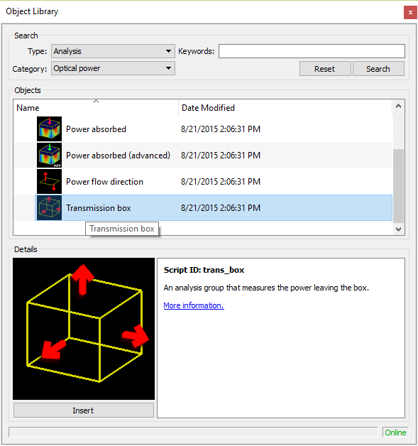
Create transmission box
To create a simulation window and edit the properties:
Analysis → Optical Power
Select Transmission box and hit Insert

Slide 25
Create transmission box
z (um) = 0

Slide 26
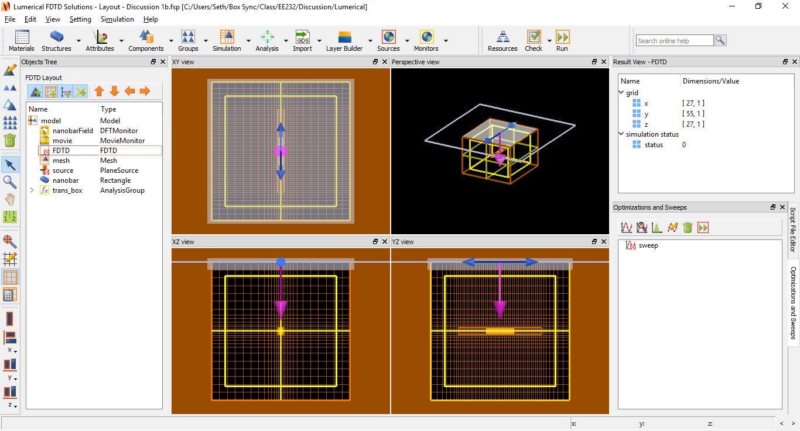
Run simulation
Click the Run icon

Slide 27
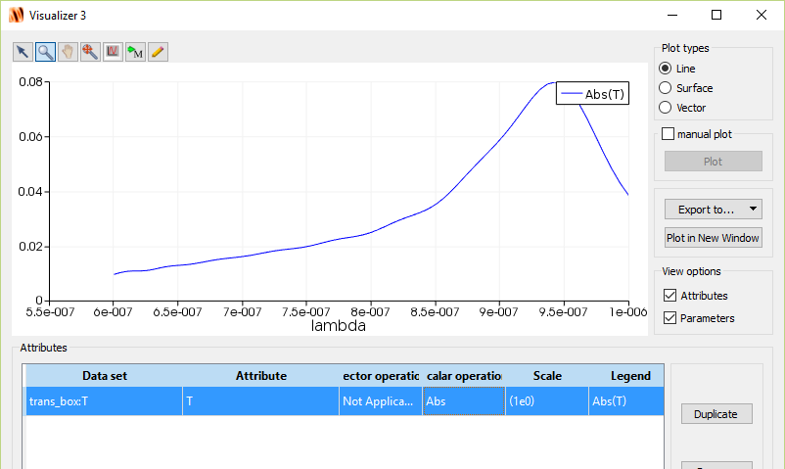
Analyze transmission box
Right-click trans_box → visualize → t
Select Abs for the Scalar Operation

Slide 28
Analyze transmission box
Transmission box measures net power that leaves the box.
The nanobar absorbs energy and therefore the net power is negative because of loss.
We observe resonance peak close to 950nm. Let’s try to optimize nanobar length to push the resonance closer to 800nm

Slide 29
Parameter sweep
Let’s fine-tune the nanobar length so that resonance peak occurs closer to 800nm.
Click the icon Create New Parameter Sweep in the Optimizations and Sweeps toolbar.
Right-click sweep and click Edit

Slide 30
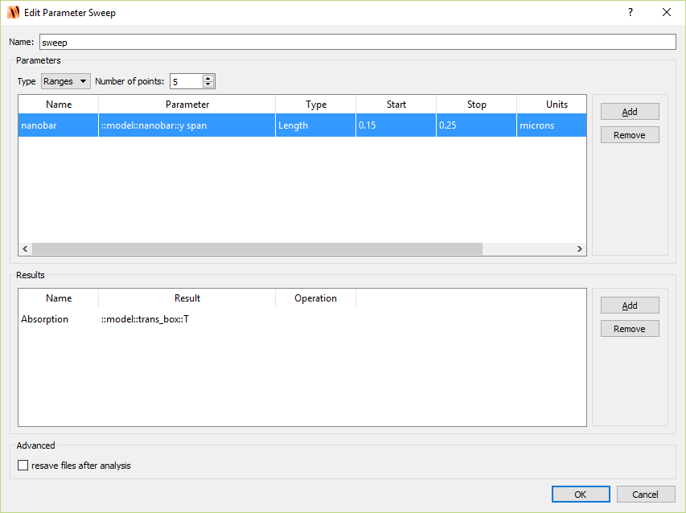
Parameter sweep

Slide 31
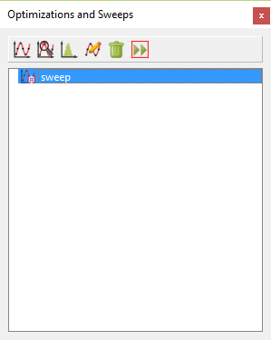
Parameter sweep
Click Run icon

Slide 32
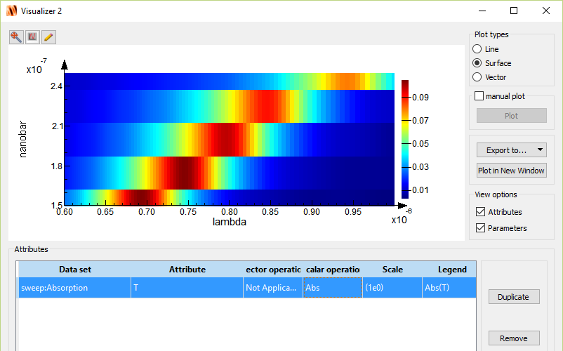
Analyze parameter sweep
Right click Sweep, select Visualize → Absorption
Select Abs for scalar operation

Slide 33
Analyze parameter sweep
Nanobar length of 200nm provides resonance peak at 800nm.
Change the nanobar geometry such that y-span is 200nm and re-run the (non-parametric sweep) simulation to analyze the field-monitor data.

Slide 34
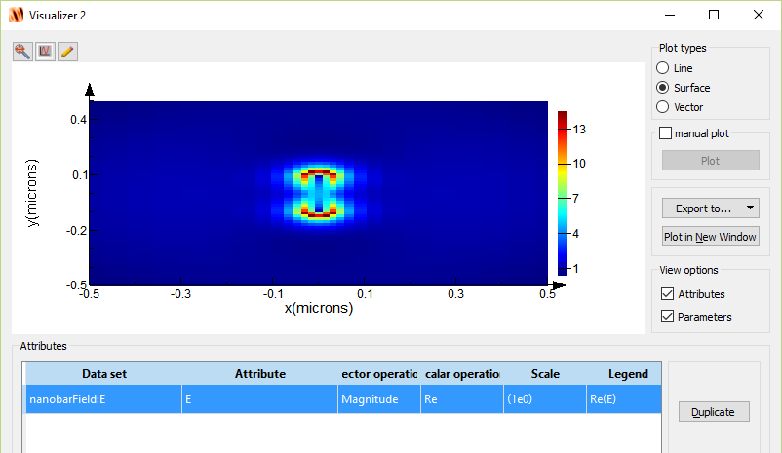
Analyze field-monitor
Right-click nanobarField → visualize → E
Click lambda in the Parameters window.
Drag the slider until Value ~ 0.8
Dipole-mode
Field is large at both ends of the nanobar

Slide 35
Movie monitor

Slide 36
Q-factor of resonance
$$Δf$$
$$Q=\frac{f}{Δf}\sim \frac{380 THz}{60 THz}=6.3$$

Slide 37
Q-factor of resonance
Less ambiguous if we measure the Q-factor in the time domain.
Recall for a general “cavity”
Therefore if we plot the field energy on dB scale we can take the linear slope of the line (m) and relate it to Q as:
$$I\left(t\right)=I_{0}e^{−ω_{0}t/Q}$$
$$10\log_{10}{I\left(t\right)}=10\log_{10}{I_{0}}−10\frac{ωt}{Q}\log_{10}{(e)}$$
$$Q=−10\frac{ω}{m}\log_{10}{(e)}$$

Slide 38
Create time monitor
To create a simulation window and edit the properties:
Monitors → Field time
Right click on TimeMonitor in Objects Tree; select Edit object

Slide 39
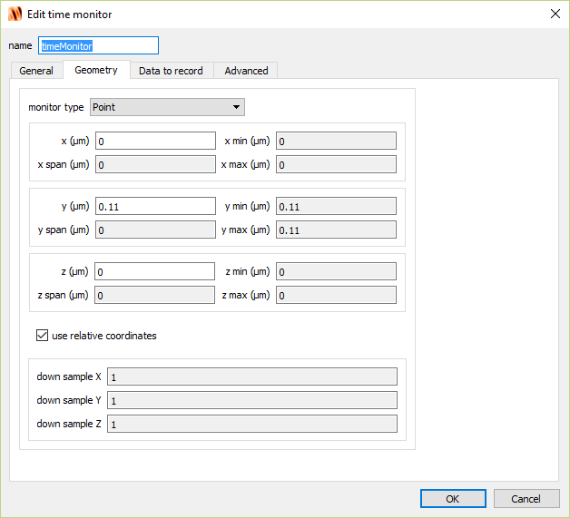
Create time monitor

Slide 40
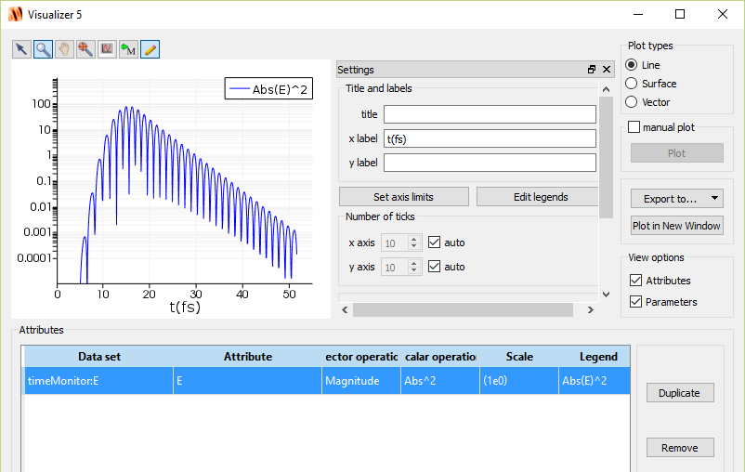
Analyze time-domain result
Run simulation
Right-click timeMonitor→ Visualize

Slide 41
Analyze time-domain result
Next we must linear fit the energy curve. This can be done through Lumerical scripting interface.
Can also export data and use scripting to fit (Matlab, Python, Excel, etc)

Slide 42
Create time monitor
Q = 7.5

